Slide 1
Improving Readability With Class Template Argument Deduction
A.J. Orians

Slide 2
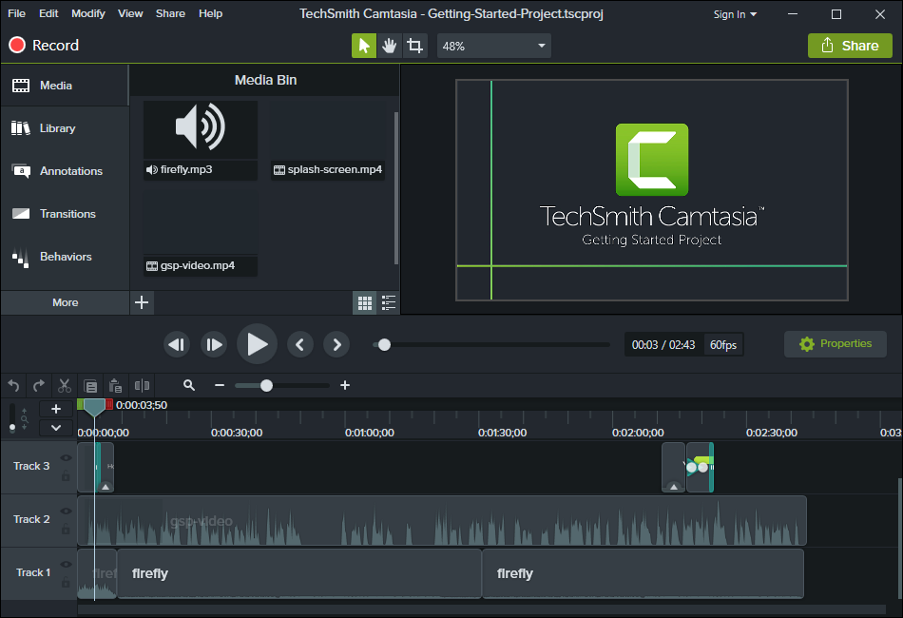
A.J. Orians
From Okemos Michigan USA
Work at TechSmith Corporation
Camtasia team

Slide 3
C++17 Features
u8 character literals
Folding expressions
Attributes for namespaces and enumerators
Nested namespace definitions
Allow constant evaluation for all non-type template arguments
Extending static_assert
New Rules for auto deduction from braced-init-list
Allow typename in a template template parameter
[[fallthrough]] attribute
[[nodiscard]] attribute
[[maybe_unused]] attribute
Extension to aggregate initialization
Wording for constexpr lambda
Unary Folds and Empty Parameter Packs
Generalizing the Range-Based For Loop
Lambda capture of *this by Value
Construction Rules for enum class variables
Hexadecimal floating literals for C++
Dynamic memory allocation for over-aligned data
Guaranteed copy elision
Refining Expression Evaluation Order for Idiomatic C++
Selection statements with initializer
Declaring non-type template parameters with auto
Using attribute namespaces without repetition
Ignoring unsupported non-standard attributes
Structured bindings
Template argument deduction for class templates
constexpr if
Make exception specifications be part of the type system
__has_include for C++17
Inline variables
A byte type definition

Slide 4
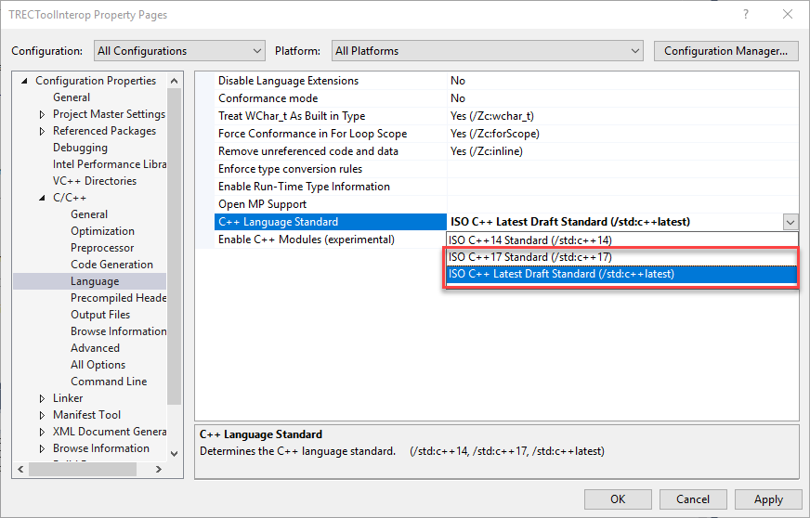

This is a C++17 Feature
Notes:
Though you might use CMake or some sort of Makefile.

Slide 5
Getting Started
vector<string> selectedFiles = GetSelectedFiles();
auto selectedFiles = GetSelectedFiles(); (C++11)
vector selectedFiles = GetSelectedFiles(); (C++17)
Sortable selectedFiles = GetSelectedFiles(); (C++20)
Notes:
There are currently three conventional ways for this assignment. There are other ways (typedef, using alias, etc). With C++20’s concepts using a concept might be pretty conventional

Slide 6
Getting Started
vector<string> selectedFiles = GetSelectedFiles();
auto selectedFiles = GetSelectedFiles(); (C++11)
vector selectedFiles = GetSelectedFiles(); (C++17)
Sortable auto selectedFiles = GetSelectedFiles(); (C++20)

Slide 7

Getting Started
vector<string> selectedFiles = GetSelectedFiles();
auto selectedFiles = GetSelectedFiles(); (C++11)
vector selectedFiles = GetSelectedFiles(); (C++17)
Sortable auto selectedFiles = GetSelectedFiles(); (C++20)
Notes:
Not sure how many know std::vector has the ability to use a custom allocator. I mention because I consider this (vector<string> ) the explicit type. Also leaving off the namespace ( std:: ) to be still explicit type.

Slide 8
Getting Started
vector<string> selectedFiles = GetSelectedFiles();
auto selectedFiles = GetSelectedFiles(); (C++11)
vector selectedFiles = GetSelectedFiles(); (C++17)
Sortable auto selectedFiles = GetSelectedFiles(); (C++20)
list<string>
int
vector<string>

Slide 9
Getting Started
vector<string> selectedFiles = GetSelectedFiles();
auto selectedFiles = GetSelectedFiles(); (C++11)
vector selectedFiles = GetSelectedFiles(); (C++17)
Sortable auto selectedFiles = GetSelectedFiles(); (C++20)
vector<string>

Slide 10
Getting Started
vector<string> selectedFiles = GetSelectedFiles();
auto selectedFiles = GetSelectedFiles(); (C++11)
vector selectedFiles = GetSelectedFiles(); (C++17)
Sortable auto selectedFiles = GetSelectedFiles(); (C++20)
vector<string>

Slide 11
Simple Examples
When you see examples like this:
vector<int> v { 1, 2, 3 };
My real-world examples tend to look more like this:
std::vector<shared_ptr<const Media> > groupMedias { _AudioMedia1, _AudioMedia2 };
Or:
std::vector< boost::shared_ptr< const CSMediaLib::CaptionableMedia > > captionList = { _Caption1, _Caption2 };
Notes:
Is vector<int> any more readable written as simply vector? What about vector<smart point< const …?
It perhaps could be a little terser. No longer need the space with nested templates where it did maximum munch. Maybe could rename the variable `grpMedias`. Could add some using namespaces.

Slide 12
What is Almost Always Auto? (AAA)
With a good name for a function/variable
Hide the type for improved readability
When you don’t need to be tied to a specific type
Paradigm shift
Less visual clutter
Less refactoring overhead
Consistency
Notes:
C++ has type safety

Slide 13
Examples of Almost Always Auto (AAA)
auto retryLimit = GetNumberOfRetries();
auto buffer = GetBuffer();
auto filenameTemplate = "%s.ext"s;
auto filenameTemplate = "%s.ext"sv;
auto currentTemp = 22.5_celsius;
auto currentTemp = Celsius{ 22.5 };
Notes:
There is the consistency aspect of Almost Always Auto (AAA) in that each of these variables are auto.

Slide 14
Classic AAA Example
Slightly wrong as the key is const
std::map<int, std::string> m;
// ...
for ( const std::pair<int, std::string>& pair : m )
{
//...
}
auto

Slide 15
Choosing not to use Almost Always Auto
Not trying to convince you; but this is how we felt about AAA:
Hides the type
Can make it harder to adjust code
Prefer traditional syntax:
Json::Value root; over auto root = Json::Value{};
std::string GetOutputFileName() over auto GetOutputFileName() -> std::string
Notes:
Some of it is our fault. From the name of the function we use it is not clear what it returns and the name of the variable could have been better. So we don’t know what the type is. In that while reading the code I might need to flip over to the header file or another file to get the actual type. Tooling can help with this.

Slide 16
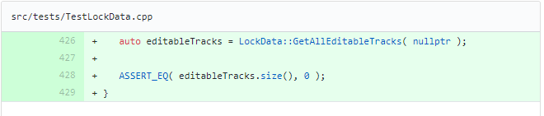
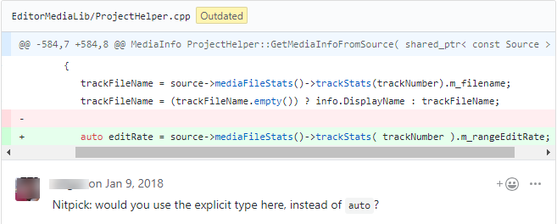
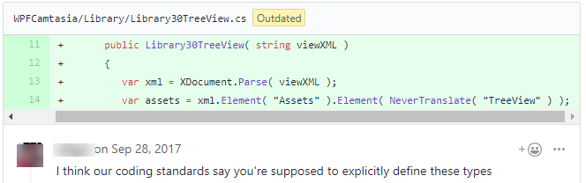
Not Using Almost Always Auto (AAA)
Notes:
We don’t use auto. Not in our test code, we ask people to change it at review time and even in our C# code (var).

Slide 17
Middle Ground: Class Template Argument Deduction
Before | After
std::vector<double> v{ 1.2, 2.3 }; | std::vector v{ 1.2, 2.3 };
std::pair<double, std::string> p{ 4.5, "Test"s }; | std::pair p{ 4.5, "Test"s };
std::tuple<int, int, int> t( 1, 2, 3 ); | std::tuple t( 1, 2, 3 );
std::array<int, 4> a = { 1, 2, 3, 4 }; | std::array a = { 1, 2, 3, 4 };
Notes:
Keeps traditional syntax, looks cleaner
To use auto keyword would use different syntax for all of them. Though 1st and last one would “work” if you didn’t mind it being a C-style array
Because I use curly braces here in the 1st example it prevents std::vector<int> v{1.2, 2.3} because narrowing conversion. I get a warning in one compiler/error in another trying to do std::vector v{1.2, 2}

Slide 18
How Does It Work?
template<typename T>
void Clamp( const T& min, T& item, const T& max)
{
/*...*/
}
int n = 5;
Clamp<int>( 2, n, 8);

Slide 19
How Does It Work?
template<typename T, typename U>
struct pair
{
pair( T one, U two );
T first;
U second;
};
template<typename T, typename U>
pair<T,U> MakePair( const T& t, const U& u)
{
pair<T, U> ret{ t, u };
return ret;
}
auto p1 = MakePair( 1, 2.3 );
pair<int, double> p2{ 1, 2.3 };

Slide 20
Syntax is a little more flexible than Auto
std::vector<double> v{ 1.2, 2.3 };
auto v { 1.2, 2.3 };//ERROR direct-list-initialization
auto v( 1.2, 2.3 );//ERROR auto can only be deduce from one item
auto v = { 1.2, 2.3 };//OK but not a std::vector
auto v = ( 1.2, 2.3 );//OK but a double (2.3) std::vector v = { 1.2, 2.3 };//OK
std::vector v { 1.2, 2.3 };//OK
Notes:
Desired to use curly braces syntax now to avoid most vexing parse; plus more consistent that way Third one is a std::initializer_list.

Slide 21
Need to specify template argument list for functions/lambdas
void Function( std::vector v )//ERROR requires template argument list
{
//...
}
std::vector Function()//ERROR deduced class type 'vector' in function return type
{
//...
}
auto
auto
Notes:
By the way, auto does work for the return type so long as the compiler is able to deduce the return type.

Slide 22
Need to specify template argument list for functions/lambdas
auto
auto lambda = []( std::vector v )//ERROR requires template argument list
{
//...
};
auto lambda = []<typename T>( std::vector<T> v )//C++20
{
//...
};

Slide 23
Good but not perfect
std::map<int, std::string> m;
// ...
for ( const std::pair& pair : m )//ERROR C2955: requires template argument list
{
//...
}
Notes:
Didn’t work in MSVC, GCC or Clang

Slide 24
Good but not perfect
std::map<int, std::string> m;
// ...
for ( std::pair pair : m )//works but undesired
{
//...
}
const auto&
Use auto instead (and const by reference)

Slide 25
Nested Types
Though this works:
list consoles {
pair{ 2001, "Xbox" },
pair{ 2005, "Xbox 360" },
pair{ 2013, "Xbox One" },
pair{ 2017, "Xbox One X" }
};

Slide 26
Nested Types
I like this better:
list<pair<int, string>> consoles {
{ 2001, "Xbox" },
{ 2005, "Xbox 360" },
{ 2013, "Xbox One" },
{ 2017, "Xbox One X" }
};
Notes:
Which do you prefer between this and the last slide?

Slide 27
Nested Types
I cannot do this:
list<pair> consoles {//ERROR: unspecialized class template
{ 2001, "Xbox" },
{ 2005, "Xbox 360" },
{ 2013, "Xbox One" },
{ 2017, "Xbox One X" }
};

Slide 28
Nested Types
LWG3028 fixes some things to facilitate this.
list consoles {
pair{ 2001, "Xbox" },
{ 2005, "Xbox 360" },
{ 2013, "Xbox One" },
{ 2017, "Xbox One X" }
};
map m{ pair{ 1, 1 },{ 2, 2 },{ 3, 3 } };

Slide 29
Another Nested Types Example
vector v{ vector{ 1, 2 } };
Creates vector<int>.
P0702R1 makes this clear

Slide 30
Shared_ptr/Unique_ptr
std::shared_ptr p = std::make_shared<MyType>();
std::shared_ptr p( new MyType() );//ERROR No matching overloaded function found
std::shared_ptr<MyType[]> p( new MyType[5] );
Both constructors receive a MyType*
Notes:
If I have a short-lived object my preference is creating objects on the stack. Meaning without the new keyword or make_shared/make_unique.
When I say “new MyType()” it is a MyType*. And when I say “new MyType[5]” it too is a MyType*.

Slide 31
Uses Type(s) from Constructing Object
std::vector< std::string > captionTexts{ "one", "two", "three", "four", "five" };
captionTexts[0] += "append";
You can use std::string_literals
std::vector captionTexts{ "one"s, "two"s, "three"s, "four"s, "five"s };
std::vector< ObjectId > _CaptionIds = { 123, 124, 125, 126, 127 };
Without template argument this is vector of ints

Slide 32
If Wanted Specific Type
Options:
Be explicit: std::vector<double> vecDouble = { 123, 124 };
Suffix: std::vector vecDouble = { 123.0, 124. };
Casts: std::vector vecDouble = { (double)123, (double)124 };
Not this please: std::vector vecDouble = std::vector<double>{ 123, 124 };
Deduction Guide
Notes:
Possibly static_cast if you want to keep your code base consistent

Slide 33
Class Template Argument Deduction
Uses only the name of the type constructing and the types of the input variables
Can use a deduction guide for when more information is necessary.

Slide 34
Deduction Guides
Adds the ability to prefer one constructor over another
Even to one that wouldn’t have been considered
Required in some cases
Every template argument must be resolved

Slide 35
Replaced With String
template<typename T>
struct S
{
S( T t )
{
std::cout << __PRETTY_FUNCTION__ << std::endl;
}
};
int main()
{
S a( "abc123" );
}
S( const char* )
->
S<std::string>;//<-- Explicit deduction guide

Slide 36
Replaced With String
template<typename T>
struct S
{
S( T t )
{
std::cout << __PRETTY_FUNCTION__ << std::endl;
}
};
int main()
{
S<std::string> a( "abc123" );
}

Slide 37
Could it be used to prevent types?
template<typename T>
struct S
{
S( const char* ) = delete;
S( T t )
{
std::cout << __PRETTY_FUNCTION__ << std::endl;
}
};
int main()
{
S a( "abc123" );
}
S( const char* ) -> S<std::false_type>;

Slide 38
Fixes Broken Connections
template<typename T>
struct S
{
template<typename Iter>
S( Iter begin, Iter end )
{
}
};
int main()
{
vector<int> vec{ 1,2,3 };
S a( vec.begin(), vec.end() );
}
template<typename Iter>
S( Iter begin, Iter end )->S<typename Iter::value_type>;

Slide 39
Default Template Parameters
= int
template<typename T >
struct S
{
S( int, double ){/*...*/ }
void Method(){/*...*/ }
};
S obj{ 1, 2.3 };

Slide 40
Getting Started
vector<string> selectedFiles = GetSelectedFiles();
auto selectedFiles = GetSelectedFiles(); (C++11)
vector selectedFiles = GetSelectedFiles(); (C++17)
Sortable auto selectedFiles = GetSelectedFiles(); (C++20)

Slide 41
Should You Use Concepts Over Explicit/Auto/Etc?
At the moment my compiler only supports 2/3rds of the Concepts syntax.
Still very new
You can think of auto as a concept
Concepts purpose is to constrain a type
template<typename TType>
concept Container = requires(TType vec, TType::value_type arg)
{
{ vec.push_back(arg) } -> std::same_as<void>;
{ static_cast<const TType>(vec).empty() } -> std::same_as<bool>;
/*...*/
};
Container auto v = GetNumbers();
Not sure if this makes sense
Notes:
A better way to phrase this question is: Are there places that use explicit syntax, auto, etc that could/should be replaced with a concept?

Slide 42
Types, Templates, Constraints
Category
Examples
Assignment
Initialization
Type
int, double, std::string,
int
n =
GetResult
();
int
n = 5;
std::vector<int>
std::string
s = "str";
Template
s
td::vector, std::pair
vector
v =
GetResult
();
vector
v{ 1, 2, 3};
r
=
GetResult
();
s
= "
str"s
Placeholder Type Specifier
a
;
uto, concept
auto
auto
v
=
{ 1, 2, 3};
auto
vector

Slide 43
Should You Use Concepts Over Explicit/Auto/Etc?
Concepts has a purpose which is to constrain a type
Concept itself isn’t a type
Functions with concepts are often templated functions
This means for me the full definition will need to be in the headers
Our preference is forward declares (incomplete type).
My code doesn’t need to be that flexible
My focus is readability first. Also releasing value.
Solve problems

Slide 44
Questions?

Slide 45
Thank You!
Thank you for having me! I hope you both enjoyed and learned a lot! ☺

